Slide 1

Nooks
Improving the Reliability of Commodity
Operating Systems
Presentation by
Mengxuan Wu

Slide 2
Nooks
Motivation
Extension Dilemma
High Privilege
Low Assurance
Executed in kernel mode, may corrupt critical kernel data and lead to crash
Account for over 70% of Linux kernel code
Over 35,000 different drivers with over 120,000 versions exist on Windows XP
Written by programmers significantly less experienced in kernel organization and programming
7 times more likely to fail than rest of the kernel in Linux
Cause 85% of recently reported failures in Windows XP

Slide 3
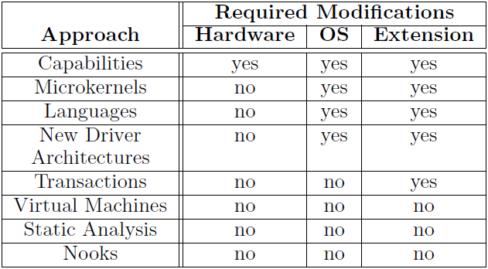
Nooks
Motivation
Reliability
Numerous researches on improving extensibility and reliability can be found.
However, most require large-scale modification

Slide 4
Nooks
Goals
Better Reliability
Isolation
Provide private domain for each extension, with limited and tracked access to kernel
Recovery
Restart the extension, but not the whole system
Backward Compatibility
Being transparent to extension, no or little change to existing extension code

Slide 5
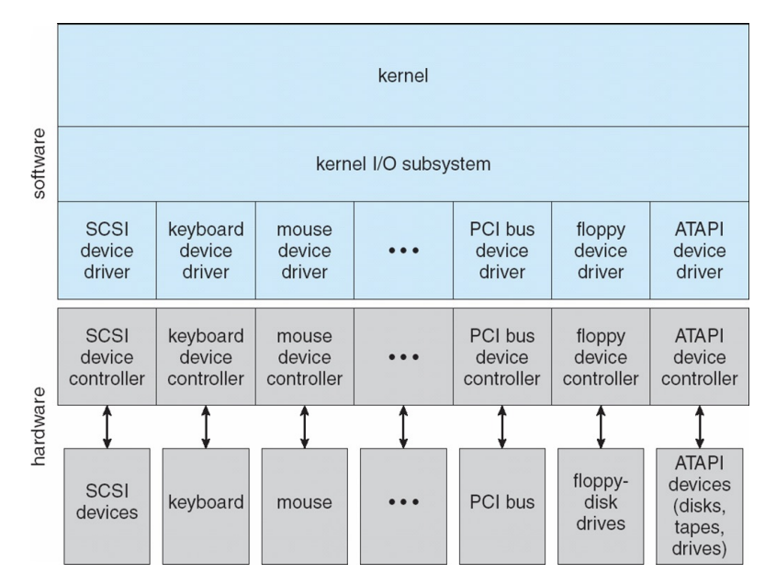
Nooks
Architecture

Slide 6
Nooks
Architecture
OS Kernel
Nooks Isolation Manager
Isolation
Interposition
Object
Tracking
Recovery
Extension

Slide 7
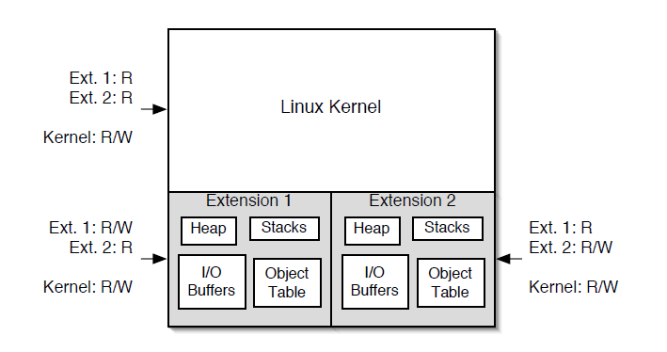
Nooks
Isolation
Lightweight Kernel Protection Domain
Lower privilege for extension which has limited write access
Single address space, with synchronized copy of page table for each extension
Extension Procedure Call (XPC) handles control transferring

Slide 8
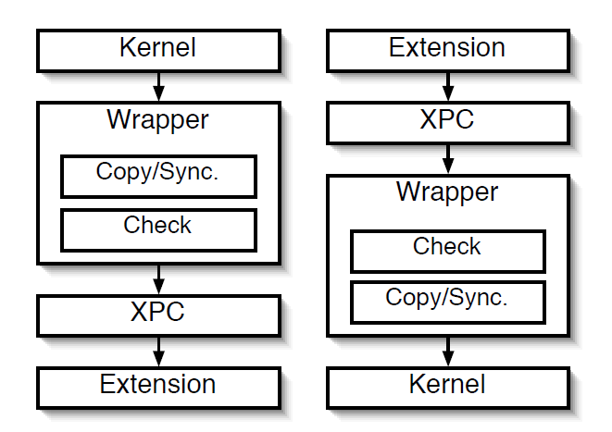
Nooks
Interposition
Wrappers
Wraps up original kernel APIs
Allow Nooks to perform checks on API parameters, and copy or sync kernel objects
Perform XPC to transfer control

Slide 9
Nooks
Interposition
More on Copy/Sync
Nooks does not allow extensions to directly write kernel objects in any case
If such a write is necessary, a copy of kernel object is created in the extension’s domain
When transferring control, wrapper checks validity of changes made by extension, then syncs the objects in different domains

Slide 10
Nooks
Object Tracking
Object Tracking
Performed inside wrappers
Tracks kernel objects (same as described in interposition)
Responsible for garbage collection

Slide 11
Nooks
Recovery
Trigger
Recovery Agent
Invalidity found by wrapper
Hardware fault
User program explicitly calls for recovery
Release all resources (object tracking) and clean reference
Reload the extension
Recover each object
Flexible, extension-wise recovery policy

Slide 12
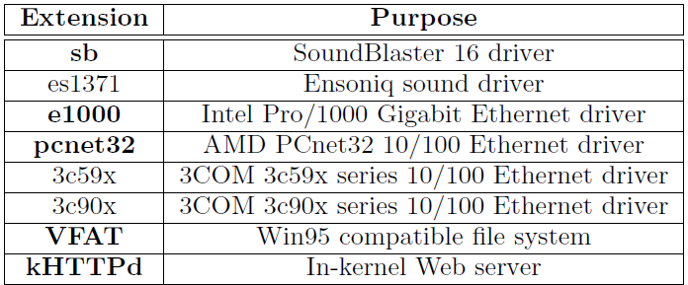
Nooks
Test Setting

Slide 13
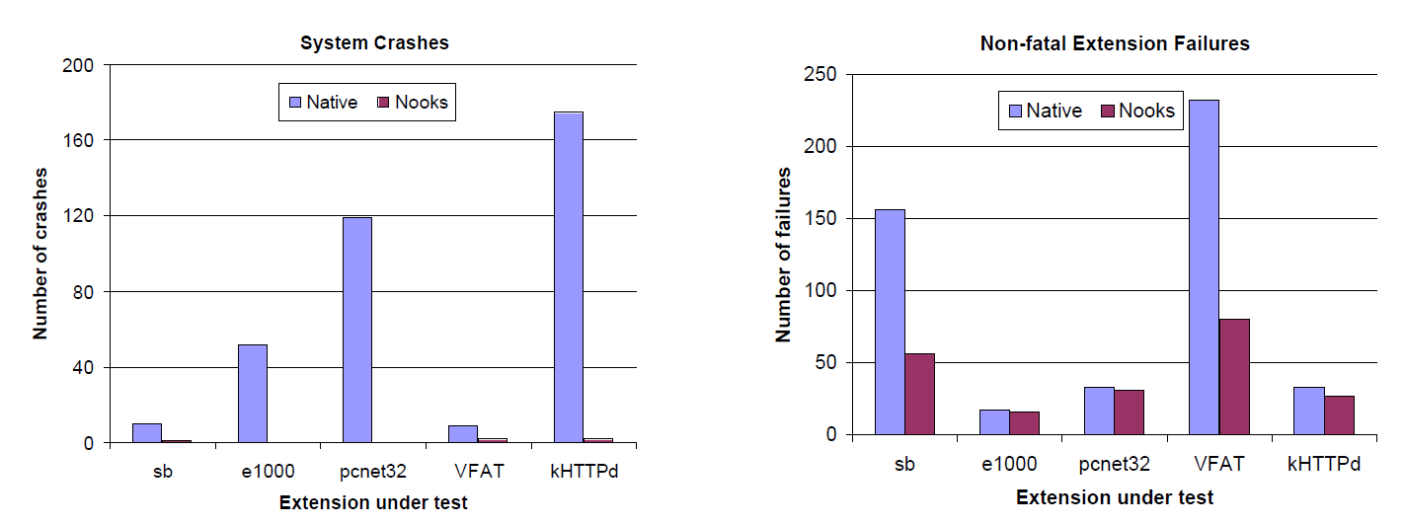
Nooks
Test Result

Slide 14
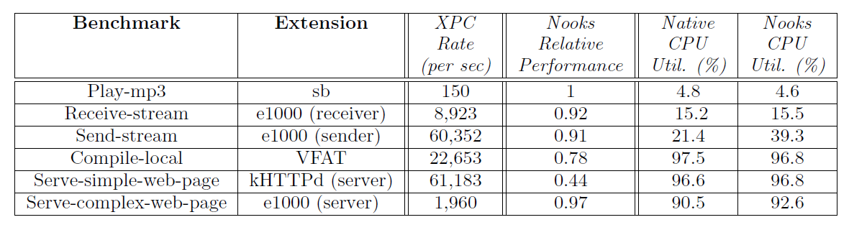
Nooks
Test Result
Trade-offs
XPC flushes TLB, leading to compulsory miss
When CPU utilization is high, performance is degraded
Object tracking is slow

Slide 15
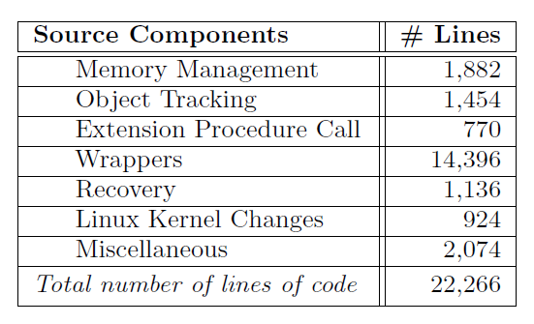
Nooks
Discussion
Discussion
Each wrapper function requires manual implementation (perform checks and copy/sync)
With only 8 drivers, we need to implement 248 wrappers. Isn’t it too costly?

Slide 16
Nooks
Discussion
Discussion
Each extension needs its own recovery policy. If each one needs to be manually written, then compatibility cannot be guaranteed (impossible to make all extension developer to write extra code).
We may provide a default one, simply restarting the extension. However, this is unsafe as restarting file system will cause data corruption in 90% of situations.

Slide 17

Nooks
Thank you for listening

